Slide 1
ASP.NET MVC CORE
Instructor: Edwin oduor

Slide 2

Quote of the day

Slide 3
Lesson objectives
Client Side validation.

Slide 4
Lesson pre-requisites
In order to take full advantage of this section you need to have the following;
Computer with Visual Studio Installed.
Stable Network Connection.

Slide 5
Training methods and extra readings
TRAINING METHODS FOR THIS LESSON
EXTRA READINGS
Lecturing Method – This is the main method of training to be adopted in this lesson with illustrations and practical coding examples.
Discussion Method - This method will be adopted periodically whereby learning will be derived principally from the students brainstorming together, rather than from the trainer. Three main types of discussions will be used:
Directed discussion
Developmental discussion
Problem-Solving discussion
Home and Learn C#

Slide 6
Client side validation.

Slide 7
When doing validation it can be done in two ways;
Server and Client side validation.
Server side validation is done at the server level while client side validation is done at the client level.
When doing validation it is good to do both validations i.e when doing server side the system will check if everything is fine before going to the server, if we only use server side validation then our system will tend to be slower because any time a command is clicked on then it will have to make trip to the server and when the server is busy processing something the user will have to wait till the request asked can be executed.
Therefore to avoid this then we can also use client side, for this validation will be done on the browser and no round trips will be done hence this one will be faster than the first one.

Slide 8

To do a client side validation then will add the following script files in the following order.
The scripts file can be added in the layout file.
If there is a file that is not pointing at the layout file and one wants to do client side validation then the script files can be added in that file.
The next validation that will do is on the modal pop up, when clicked on should display error message if one clicks on the button and the text fields are empty.
The validation will do it using javascript.

Slide 9
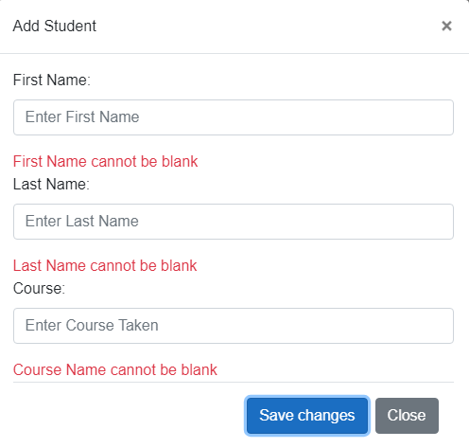
This is what will achieve.

Slide 10

To achieve the form validation as shown in the previous slide I will take a screen shot of the first line of the form and the input box of the first name.
Will create a function (validate) and inside our function will have the code to do validation of the form.

Slide 11


Inside the function we are creating variables I will work with the first one so that you will understand.
Then we are using if statement to check the length of what is inside the variable, then display message if what being checked for does not meet expectation.
The same is being repeated to all other variables.
Name of the form
Name of the input box

Slide 12
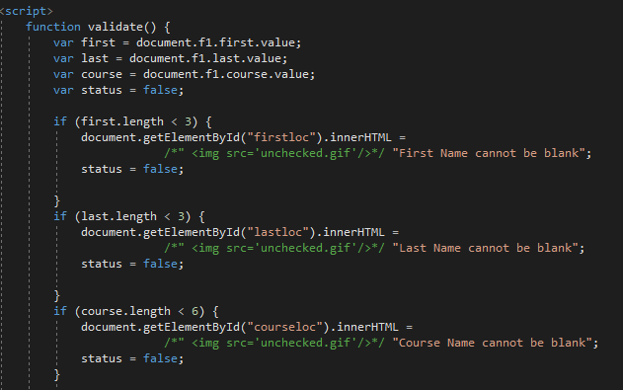
This is the entire code inside the function that will create.

Slide 13
exercise.

Slide 14
Do client side validation for the other modals in the project.

